Slide 1
IndiaSkills Competitions 2023
&
WorldSkills Competition 2024

Slide 2
1
IndiaSkills Competitions 2023
OUR SKILLS, OUR FUTURE

Slide 3
About WorldSkills and WorldSkills Competitions
Founded in 1950, WorldSkills is a global organisation that promotes vocational, technological, and service- oriented education and training.
WorldSkills promote skilled careers in 86 Member countries and regions, all working with youth, educators, governments and industries to help prepare the workforce and talent of today for the jobs of the future.
WorldSkills Competition is a biennial Competition.
Last WorldSkills Competition took place in 2022 and next is planned in 2024 at Lyon, France
Eligibility Criteria is Age and Skills. For WorldSkills Lyon : Born on and after 1 Jan 2002. For Some Skills it is born on and after 1 Jan 1999

Slide 4
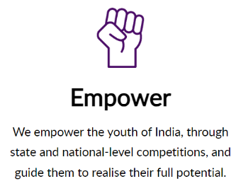
About WorldSkills India
WorldSkills India makes skills aspirational, inspires young talent, drives sectoral development, and helps stimulate the country’s economy.

Slide 5
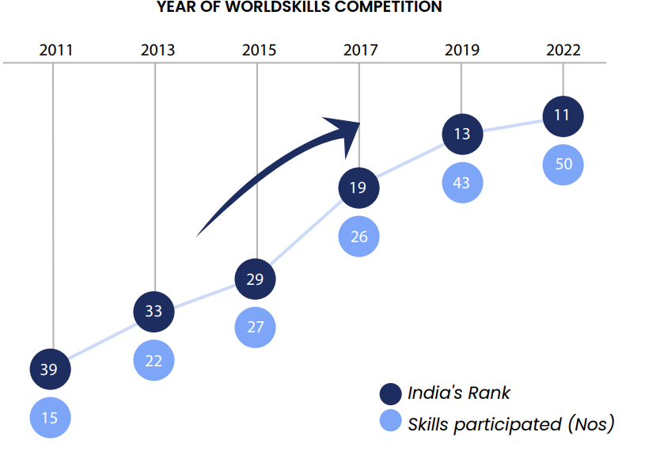
India at WorldSkills Competitions
In WorldSkills Competition 2022:
2 Silver Medals
3 Bronze Medals
13 Medallion for Excellence

Slide 6
About IndiaSkills Competition
Key Objectives:
Promulgate skills in society to motivate the youth to pursue vocational education
Champion skills and learning for work through local, regional, national and international skills competitions
Create partnership network comprising governments, industry, academic partners, Vocational Education and Training (VET) institutions, trade associations and youth to promote skills
Facilitate cooperation among governments, industry and academia
Help the Indian youth attain world-class standards of competence, excellence and productivity

Slide 7
IndiaSkills Competition – Timelines
* On Skill India Digital

Slide 8
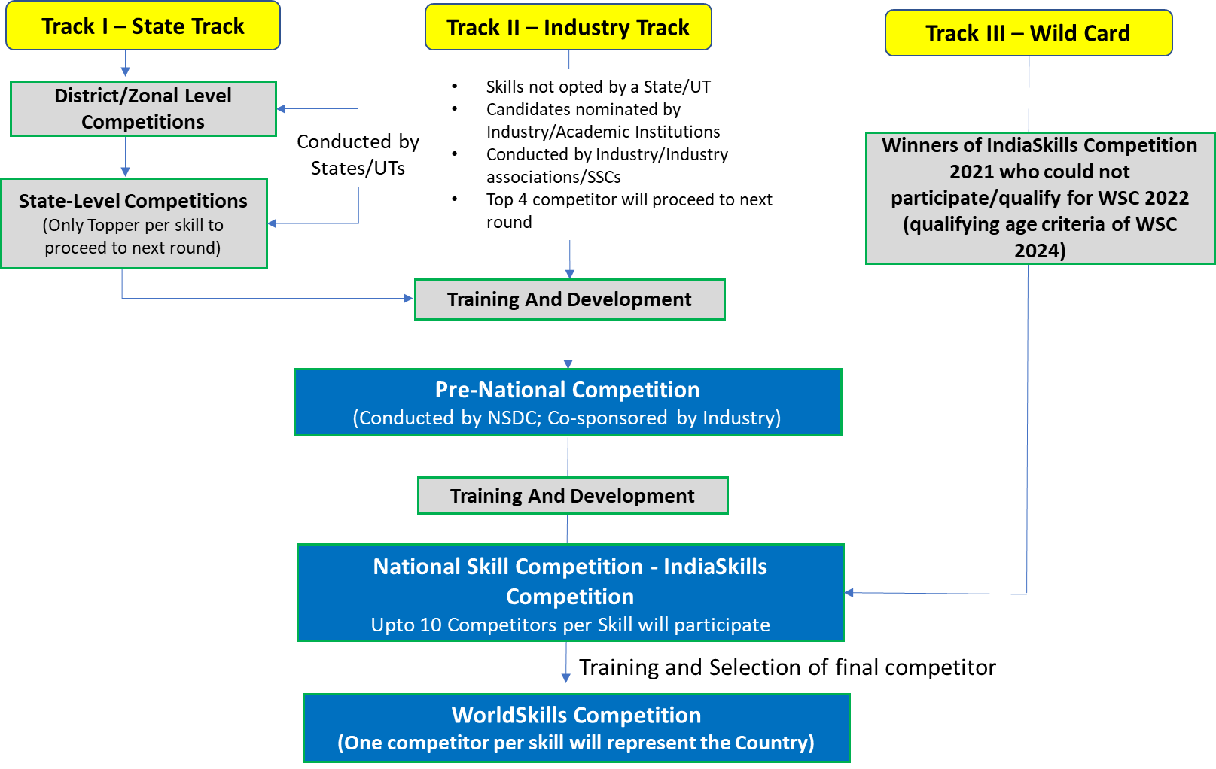
About IndiaSkills – Selection Process

Slide 9
50+ Areas of Skill Competition
Sl. | Sector | Skill name | No. of Competitors | Eligibility for WSC 2024 (Born on or after)
1 | Construction and Building Technology | Wall and Floor Tiling | 1 | 1st January 2002
2 |  | Plumbing and Heating | 1 | 1st January 2002
3 |  | Electrical Installations | 1 | 1st January 2002
4 |  | Bricklaying | 1 | 1st January 2002
5 |  | Plastering and Drywall Systems | 1 | 1st January 2002
6 |  | Painting and Decorating | 1 | 1st January 2002
7 |  | Cabinetmaking | 1 | 1st January 2002
8 |  | Joinery | 1 | 1st January 2002
9 |  | Carpentry | 1 | 1st January 2002
10 |  | Refrigeration and Air Conditioning | 1 | 1st January 2002
11 |  | Concrete Construction Work | 2 | 1st January 2002
12 |  | Digital Construction | 1 | 1st January 1999
13 | Creative Arts and Fashion | Jewellery | 1 | 1st January 2002
14 |  | Floristry | 1 | 1st January 2002
15 |  | Fashion Technology | 1 | 1st January 2002
16 |  | Graphic Design Technology | 1 | 1st January 2002
17 |  | Visual Merchandising | 1 | 1st January 2002
18 |  | 3D Digital Game Art | 1 | 1st January 2002

Slide 10
50+ Areas of Skill Competition
Sl. | Sector | Skill name | No. of Competitors | Eligibility for WSC 2024 (Born on or after)
19 | Information and Communication Technology | Information Network Cabling | 1 | 1st January 1999
20 |  | IT Software Solutions for Business | 1 | 1st January 2002
21 |  | Web Technologies | 1 | 1st January 2002
22 |  | Cloud Computing | 1 | 1st January 1999
23 |  | Cyber Security | 2 | 1st January 1999
24 |  | Mobile Applications Development | 1 | 1st January 2002
25 | Manufacturing and Engineering Technology | Mechatronics | 2 | 1st January 1999
26 |  | Mechanical Engineering CAD | 1 | 1st January 2002
27 |  | CNC Turning | 1 | 1st January 2002
28 |  | CNC Milling | 1 | 1st January 2002
29 |  | Welding | 1 | 1st January 2002
30 |  | Electronics | 1 | 1st January 2002
31 |  | Industrial Control | 1 | 1st January 2002
32 |  | Autonomous Mobile Robotics | 2 | 1st January 2002
33 |  | Chemical Laboratory Technology* | 1 | 1st January 2002
34 |  | Water Technology | 1 | 1st January 1999
35 |  | Industrial Design Technology | 1 | 1st January 1999
36 |  | Renewable Energy | 1 | 1st January 2002
37 |  | Robot Systems Integration | 2 | 1st January 1999
38 |  | Industry 4.0 | 2 | 1st January 1999
39 |  | Manufacturing Team Challenge* | 3 | 1st January 1999
40 |  | Additive Manufacturing | 1 | 1st January 1999

Slide 11
50+ Areas of Skill Competition
Sl. | Sector | Skill name | No. of Competitors | Eligibility for WSC 2024 (Born on or after)
41 | Social and Personal Services | Hairdressing | 1 | 1st January 2002
42 |  | Beauty Therapy | 1 | 1st January 2002
43 |  | Pâtisserie and Confectionery | 1 | 1st January 2002
44 |  | Cooking | 1 | 1st January 2002
45 |  | Restaurant Service | 1 | 1st January 2002
46 |  | Health and Social Care | 1 | 1st January 2002
47 |  | Bakery | 1 | 1st January 2002
48 |  | Hotel Reception | 1 | 1st January 2002
49 | Transportation and Logistics | Autobody Repair | 1 | 1st January 2002
50 |  | Automobile Technology | 1 | 1st January 2002
51 |  | Car Painting | 1 | 1st January 2002
52 |  | Logistics & Freight Forwarding* | 1 | 1st January 2002
53 | Special/Exhibition Skills# | Shoe Making | 1 | 1st January 1999
54 |  | Garment & leather accessories making | 1 | 1st January 1999
55 |  | Textile Design | 1 | 1st January 1999
56 |  | Textile Weaving - Handloom | 1 | 1st January 1999
57 |  | Yoga | 1 | 1st January 1999
58 |  | Costume Design | 1 | 1st January 1999
59 |  | Prosthetic & Makeup | 1 | 1st January 1999
60 |  | AR/VR | 1 | 1st January 1999
61 |  | Drone Film Making | 1 | 1st January 1999

Slide 12
Registration for IndiaSkills Competition 2023
On 17th October 2023, Shri. Dharmendra Pradhan Honourable Minister of Education, Skill Development and Entrepreneurship has launched IndiaSkills Competition 2023.
Registrations are open at Skill India Digital : https://www.skillindiadigital.gov.in/home.
As of now registrations will be done only on web browser not on the app.
Attached is the user guideline for the registration process.

Slide 13
2
Highlights of National Skill Competition 2021
IndiaSkills 2021

Slide 14
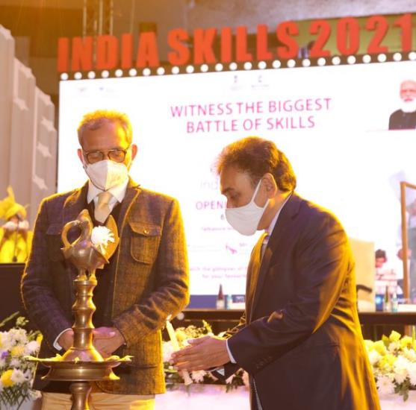
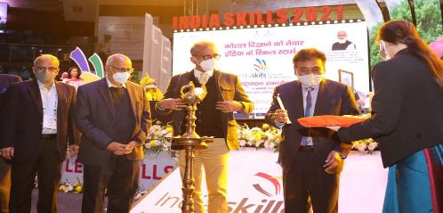
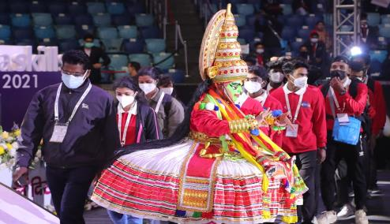
National Skill Competition
IndiaSkills 2021- Opening Ceremony

Slide 15
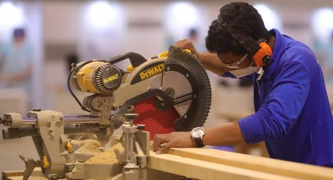
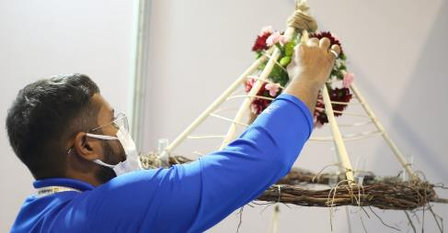
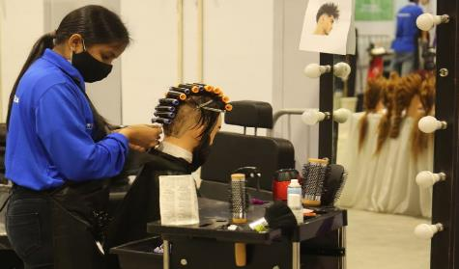
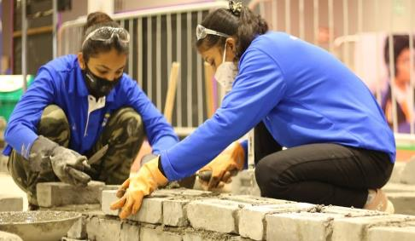
National Skill Competition
IndiaSkills 2021 – Competition Glimpses

Slide 16
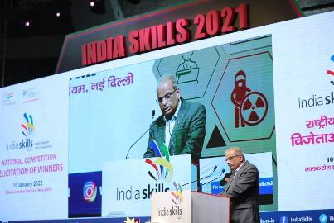
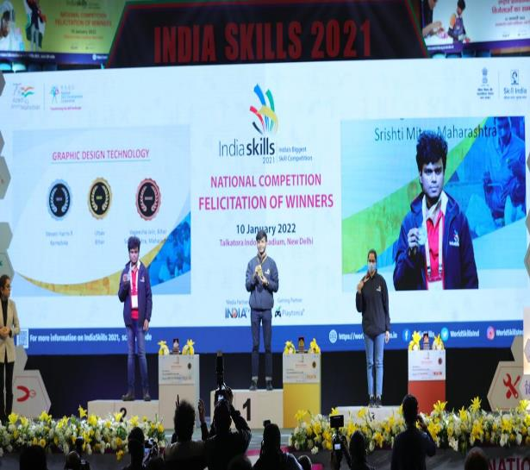
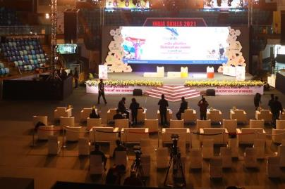
National Skill Competition
IndiaSkills 2021 – Closing Ceremony

Slide 17
NSDC – Changes Lives
Mufeed Hamzakutty
WorldSkills Competition 2022
Skill : Cyber Security
Owns a start-up Lyminal – Cyber Security
Subhasis Paul
WorldSkills Competition 2022
Skill : Jewellery, Medallion
Designer in VB Jewellers, Chennai
Abhinav Verma
WorldSkills Competition 2022
Skill : 3d Digital Game Art, Medallion
Designer in Lakshya Digital
Akhilesh N
WorldSkills Competition 2022
Skill : Mechatronics, Bronze
Trainer in Toyota, TTTI
Anushree S
WorldSkills Competition 2022
Skill : Hotel Reception, Bronze
Associate at WeWork India
Sonu Lather
WorldSkills Competition 2022
Skill : Autobody Repair, Medallion
Instructor in Maruti Suzuki
Charmi Sen
WorldSkills Competition 2022
Skill : Hair Dressing, Medallion
Hair Stylist at Bblunt - MamaEarth
Vaisakh
WorldSkills Competition 2022
Skill :Information Network Cabling, Medallion
Deputy Head – IT , Daymart

Slide 18
NSDC – Changes Lives

Slide 19
Our Partners

Slide 20
How to Reach Us
For more information, please contact us.
worldskillsindia@nsdcindia.org
?
Thank you !

